Slide 1
Digital Communication
Notes:
Let’s begin a discussion on Digital Communication

Slide 2
Objectives
At the end of this session, you will be able to:
  Understand digital signal representation and its characteristic features
  Understand the need of digital transmission and edge over analogue counterpart
  Understand the process of analogue to digital conversion called PCM – Pulse Code Modulation
  Understand quantization step in PCM, quantization error and its impact on quality of digital quality

Slide 3
Agenda
Digital Signal characteristics
Advantage of digital transmission
Analogue to Digital conversion process

Slide 4
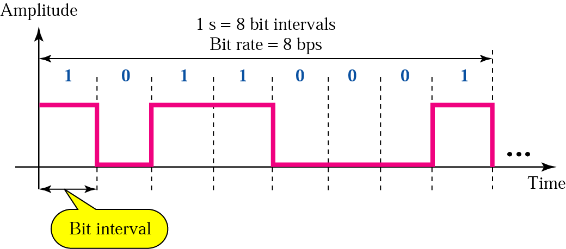
Digital Signal: Bit Rate and Bit Interval
Notes:
Digital signal can be thought of as series of 1’s and 0’s.
We have already seen concepts like bit interval, bit rate and so on…

Slide 5
Why Digital Transmission?
Technology
  Drop in COST, shrink in SIZE as well as POWER due to LSI,VLSI technology
Capacity utilization
  Digital techniques can more easily and cheaply utilize available transmission links of high bandwidth through multiplexing
Better noise immunity
Security and privacy
Compression and decompression
Source independent !!!
Error detection & correction methods can be used
In general, more efficient & reliable means of communication
Notes:
Technology: Sees a drop in cost due to LSI and VLSI
Capacity utilization : Digital techniques can more easily and cheaply utilize, through multiplexing, available transmission links of high bandwidth. Security and privacy: Encryption techniques are more readily applied to digital data

Slide 6
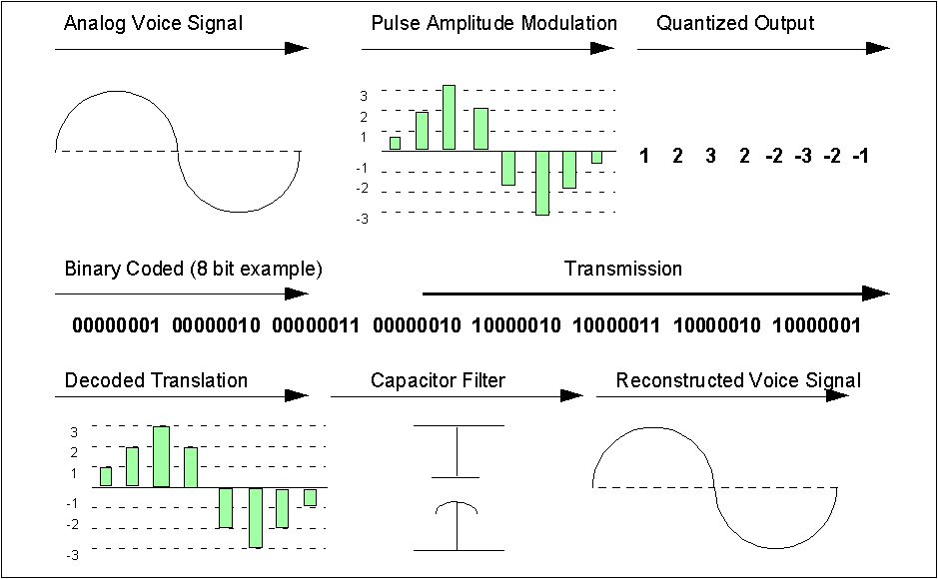
PCM Process
Notes:
A/D conversion technique called Pulse Code Modulation PCM involves following processes:
Sampling/Pulse Amplitude Modulation (PAM)
Quantization: which when combined with sampling, allows for representing Analog signal in Discrete form.
Compression forms an important part in Quantization.
Corresponding TO NA/Europe we have μ-law or A-law compression techniques.
Encoding process: To translate the discrete set of sample values to a more appropriate form of signal.
Transmitting: Sending the bits in suitable form by using line coding techniques
PCM generator produces a series of numbers, or digits.Each one of these digits(in binary code) always represents the approximate amplitude of the signal sample at that instant.

Slide 7
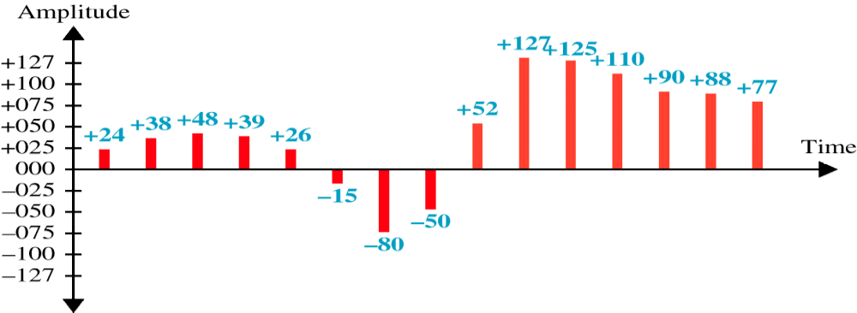
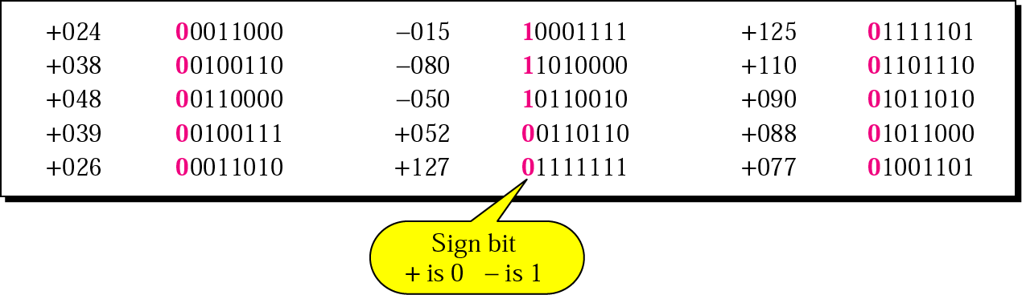
Quantized PAM Signal
Quantizing by using sign and magnitude

Slide 8
Summary
In this session, we have learned:
  Digital signal representation and its characteristic features
  The need of digital transmission and edge over analogue counterpart
  Process of analogue to digital conversion called PCM – Pulse Code Modulation
  Quantization error and its impact on digital quality

Slide 9
Thank You

